Slide 1
Create an intelligent system using AI/ML to detect phishing domains which imitate look and feel of genuine domains
PIP4004 University Project-II
Review-3
Batch Number: CSE-G18
Roll Number | Student Name
HEMA DEEPIKA | 20211CSE0324
ISHA BHARDWAJ | 20211CSE0331
Under the Supervision of,
Dr. / Pamela Vinitha Eric
Professor / Associate Professor / Assistant Professor
School of Computer Science & Engineering
Presidency University

Slide 2
Introduction
Phishing attacks have become a major cybersecurity threat, where attackers create fraudulent websites that mimic legitimate domains to deceive users into revealing sensitive information. Traditional security measures, such as blacklists and rule-based detection systems, are insufficient due to the rapid evolution of phishing techniques.
Artificial Intelligence (AI) and Machine Learning (ML) offer robust solutions to detect phishing domains by analyzing patterns, structures, and visual similarities to genuine domains.
Our topic proposes an AI/ML-based intelligent system that identifies phishing domains by evaluating their characteristics, including lexical features, visual similarity, and SSL certificate information.

Slide 3
GitHub Access
https://github.com/Deepika-27-sys/FinalProjectPhishing

Slide 4
Literature Review
Author(s) | Year of Publish | Paper Title | Key Points | Merits | Demerits
Niakanlahiji, A., et al | 2023 | Life-long phishing attack detection using continual learning | Introduces an ensemble of RF, neural networks, and Bagging, achieving 97.4% accuracy in detecting phishing web pages. | High accuracy and effective use of ensemble techniques for robust detection. | Performance may vary with evolving phishing tactics over time.
Shirazi, A., et al. | 2024 | Phishing URL detection with neural networks: an empirical study | Utilizes deterministic and probabilistic neural networks for URL classification, achieving 97% accuracy using a combination of datasets. | Successful in real-world applications and demonstrates high classification accuracy. | Relies heavily on feature engineering; mislabeled data could affect results.
Gopal, S. | 2020 | Phishing Website Detection by Machine Learning Techniques | Trains various ML models on a dataset of phishing and legitimate URLs to predict phishing websites. XGBoost shows the highest performance at 86.4%. | Comprehensive approach using multiple models; practical application for real-time detection. | Limited dataset size may affect generalizability of results.
Ramesh, S., et al. | 2022 | Detection of Phishing Websites by Using Machine Learning Algorithms | Analyzes URLs using eight different ML algorithms across three datasets to identify the most effective method for phishing detection. | Provides a comparative analysis that highlights the strengths of different algorithms. | May not cover all possible phishing tactics; reliance on specific datasets could limit applicability.
Gupta, A., et al. | 2018 | Phishing Website Detection Using Machine Learning: A Review | Reviews various techniques and algorithms used for phishing website detection, summarizing previous studies and their findings. | Offers a comprehensive overview of existing research and methodologies in the field. | Lacks original experimental data; primarily a literature review without new insights.
Chiew, K.L., et al. | 2023 | Logo-based Phishing Website Detection Methodology | Employs a two-stage method to extract logos from websites to detect phishing sites by comparing domains associated with logos. | Innovative approach utilizing visual elements for detection; can enhance traditional methods. | May struggle with sites that do not have recognizable logos or those that frequently change logos.
Alabdullah, N., et al. | 2021 | A machine learning-based approach to detect phishing attacks | Proposes a model that utilizes various features to effectively detect phishing websites using machine learning techniques. | Focuses on feature extraction for improved accuracy in detection processes. | Limited discussion on real-world applicability; potential overfitting issues not addressed.

Slide 5
Proposed Method
We propose a hybrid AI/ML-based system that integrates lexical analysis, visual similarity detection, and SSL certificate verification. The system consists of the following components:
Domain Feature Extraction: Extracts various domain-related characteristics, including URL structure, length, presence of special characters, domain age, WHOIS information, and subdomains.
Visual Similarity Detection: Uses image processing techniques and Convolutional Neural Networks (CNNs) to compare the graphical layout of a suspected phishing page with known legitimate websites.
SSL and Metadata Analysis: Verifies the SSL certificate's issuer, validity, encryption type, and whether the certificate matches the domain. Additionally, it examines HTTP headers and other metadata to detect phishing patterns.
ML Model for Classification: Implements supervised learning algorithms such as Random Forest, Support Vector Machines (SVM), and Neural Networks to classify domains as legitimate or phishing. Feature selection is optimized using techniques like Recursive Feature Elimination (RFE) to improve accuracy.
Real-Time Monitoring and Adaptive Learning: The system continuously updates its model by integrating new phishing samples and retraining periodically to adapt to evolving phishing techniques

Slide 6
Existing Drawbacks
1. Dependence on Access Logs Only (Reactive Detection)
Issue: It can only detect phishing kits after they have been accessed and logged on the server (reactive approach).
Impact: If attackers haven't made a request yet, you won't detect the phishing kit.
Solution/Improvement:
Combine this technique with active scanning tools (e.g., domain crawlers, Google Safe Browsing API) to proactively find phishing sites using your assets.
Use DNS monitoring to track suspicious domains as soon as they're registered.
2. False Positives & False Negatives (Accuracy Issues)
Issue: False positives: Legitimate third-party tools may reference your JavaScript or CSS files and get flagged.
False negatives: If phishing kits rename your files or obfuscate them, they might bypass detection.
Impact: Reduced trust in results and missed phishing campaigns.
Solution/Improvement: Enhance tracking_file_request regex to account for common obfuscations or renaming patterns.
Use hashing (SHA256) of legitimate assets to track reused content, even if renamed.
Incorporate AI/ML models to learn and detect sophisticated phishing kits dynamically (future upgrade).
3. Static Signature-based Detection (Limited Adaptability)
Issue: Current detection depends on predefined patterns in defaults.conf. If attackers change tactics, tool may become ineffective.
Impact: Limited adaptability to new phishing techniques.
Solution/Improvement: Regularly update signature lists (e.g., from threat intelligence feeds).
Add heuristic or anomaly detection capabilities to identify unknown threats based on behavior, not just patterns.
4. Requires Manual Log Management (Operational Overhead)
Issue: Needs someone to manually run the tool and manage log files.
Impact: Time-consuming and error-prone.
Solution/Improvement:
Automate the tool execution via cron jobs or scheduled tasks.
Develop a dashboard to visualize detections in real-time.

Slide 7
Objectives
1.Detect Reuse of Legitimate Website Assets by Phishing Kits
Goal: Identify phishing kits that steal and reuse legitimate resources (e.g., JavaScript, CSS, images) from a targeted website.
Why: Phishing sites often copy assets to look like real websites. Detecting access to these assets can reveal phishing activity.
2. Analyze Access Logs to Identify Suspicious Requests
Goal: Automatically analyze web server access logs to find unusual or suspicious file requests.
Why: These requests may indicate that attackers are using stolen assets to create a phishing site.
3. Detect Non-legitimate (Suspicious) Referrer URLs
Goal: Find HTTP referrers that are not part of legitimate domains, suggesting possible phishing or malicious use.
Why: If another site is referencing (linking to) legitimate files, it may be hosting a phishing page using those assets.
4. Generate Reports of Potential Phishing Kit Activities
Goal: Output results in a structured format (CSV report) listing all suspicious activities detected.
Why: Helps security teams quickly investigate and respond to phishing threats.
5. Flexible and Customizable Detection Patterns
Goal: Allow users to define and customize regular expressions (RegEx) for different types of phishing detection via a configuration file.
Why: Makes the tool adaptable for different websites and changing phishing tactics.
6. Support for Proxy-based Threat Hunting (Optional)
Goal: (Optional) Allow connections through HTTP/SOCKS proxies to gather additional information about suspicious requests.
Why: Useful for investigating phishing sites without exposing real IP addresses.

Slide 8
Methodology
1. Data Collection: The first step involves gathering data from multiple sources, including PhishTank, OpenPhish, and Alexa Top Sites. These datasets provide labeled phishing and legitimate domain data for training and evaluation.
2. Feature Engineering: Various features such as lexical attributes (URL length, domain entropy), visual elements (website screenshots, HTML structure), and security parameters (SSL certificate validity, HTTP headers) are extracted and processed.
3. Preprocessing and Data Cleaning: The collected data undergoes cleaning and transformation, including removing duplicate records, handling missing values, and normalizing numerical attributes.
4. Model Selection and Training: Multiple machine learning models (Random Forest, Support Vector Machine, XGBoost, and Deep Neural Networks) are trained using labeled data. Hyperparameter tuning and cross-validation techniques are applied to optimize model performance.
5. Evaluation Metrics: Performance is measured using accuracy, precision, recall, F1-score, and AUC-ROC curves. These metrics help in assessing the efficiency of different models.
6. Deployment and Integration: The best-performing model is integrated into a real-time phishing detection system. This system is deployed as an API or browser extension for instant verification of suspicious domains.
7. Continuous Learning and Model Updating: The system incorporates new phishing patterns by periodically retraining the model with updated datasets to maintain its effectiveness against evolving threats.

Slide 9
Algorithm
Step 1: Data Collection
Gather datasets of phishing and legitimate domains from sources like:
PhishTank
OpenPhish
Alexa Top Sites (for legitimate domains)
WHOIS databases
Extract HTML content, URLs, SSL certificates, and DNS records.
Step 2: Feature Extraction
(A) URL-Based Features
Length of the URL (Phishing URLs tend to be longer).
Use of special characters (@, -, _, %, etc.).
Presence of subdomains (login.bank.example.com vs. bank-example.com).
Misspelled domains (e.g., faceboook.com instead of facebook.com).
Use of IP address in the URL (Instead of domain names).
(B) Domain-Based Features
WHOIS information (Check domain age, registrar, and owner details).
Time since domain registration (Phishing domains are often newly registered).
SSL Certificate validation (Self-signed vs. valid certificate).

Slide 10
Hosting and server location (Suspicious locations).
(C) Page-Based Features
Visual Similarity (Computer Vision + CNNs)
Compare screenshots of the suspected phishing site with genuine sites using CNN-based image similarity models.
Use SIFT (Scale-Invariant Feature Transform) or ORB (Oriented FAST and Rotated BRIEF) to compare logos and images.
Text Similarity (NLP-Based)
Extract text using OCR and compare with original sites using TF-IDF, BERT, or cosine similarity.
Detect keyword stuffing or misleading text.
(D) Network-Based Features
Redirects to another domain (Check for multiple redirections).
Malicious JavaScript scripts (Check for hidden redirections).
Presence on blacklists (Cross-check with Google Safe Browsing API and other security lists).
Step 3: Model Training
Supervised Learning Models
Random Forest, XGBoost, SVM, or Deep Neural Networks (DNNs) for classification.
Train the model on labeled datasets of phishing and non-phishing sites.
Unsupervised Learning Models (For zero-day phishing attacks)
Autoencoders or Anomaly Detection (Isolation Forest, DBSCAN) for identifying unknown phishing domains.
Reinforcement Learning (Optional)
Improve detection accuracy by continuously learning from flagged phishing attempts.
Step 4: Model Deployment
Deploy the trained model as a REST API using Flask/Django or on cloud platforms like AWS, Azure, or Google Cloud.
Create a browser extension or web application that users can use to check URLs.

Slide 11
Step 5: Real-Time Detection and Alert System
A real-time monitoring system continuously scans new domains.
If a phishing domain is detected:
Block the site or warn users via browser extension.
Report the site to cybersecurity organizations (e.g., Google Safe Browsing).
Step 6: Continuous Learning and Feedback Loop
Regularly update the model with new phishing sites.
Implement a user feedback mechanism (users can report false positives/negatives).
Use federated learning to improve the model without exposing user data.

Slide 12
Summary of the components used
Component | Technique
Feature Extraction | NLP (TF-IDF, BERT), Computer Vision (CNN, SIFT), URL analysis
ML Model | Random Forest, XGBoost, SVM, Deep Learning
Deployment | Flask/Django API, Web App, Browser Extension
Real-Time Monitoring | Blacklists, DNS, WHOIS, SSL verification

Slide 13
Timeline of Project
S. No. | Review (Offline) | Dates
1 | Review-0 | 29-Jan-2025 To 31-Jan-2025
2 | Review-1 | 18-Feb-2025 To 21-Feb-2025
3 | Review-2 | 17-Mar-2025 To 21-Mar-2025
4 | Review-3 | 21-Apr-2025 To 26-Apr-2025
5 | Final Viva-Voce * | 12-5-2025 TO 24-5-2025* *Subject to End Term Exam Dates

Slide 14
Expected Outcomes
High Detection Accuracy: The AI/ML model is expected to achieve high precision and recall in detecting phishing domains, minimizing both false positives and false negatives.
Real-Time Detection: The system will provide instant classification of domains, allowing users to quickly identify potential phishing threats.
Scalability and Adaptability: The solution will be capable of handling large-scale domain analysis and adapting to emerging phishing techniques through continuous learning.
User Awareness and Protection: By deploying the system as a browser extension or API service, users will receive real-time alerts, enhancing their security awareness.
Contribution to Cybersecurity Research: The project will provide valuable insights into phishing detection methodologies, contributing to ongoing research in AI-driven cybersecurity solutions.

Slide 15
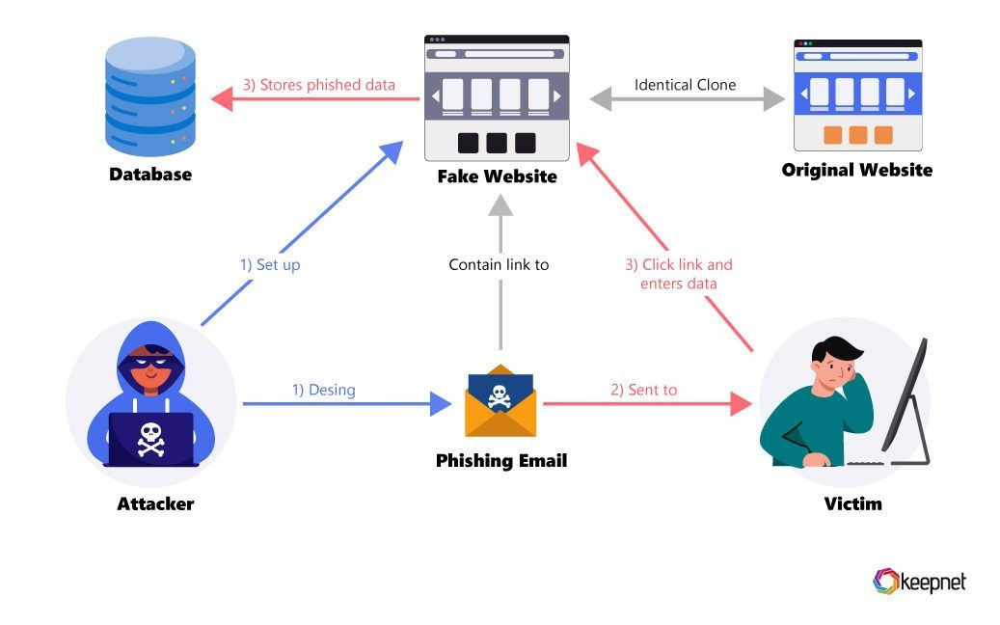
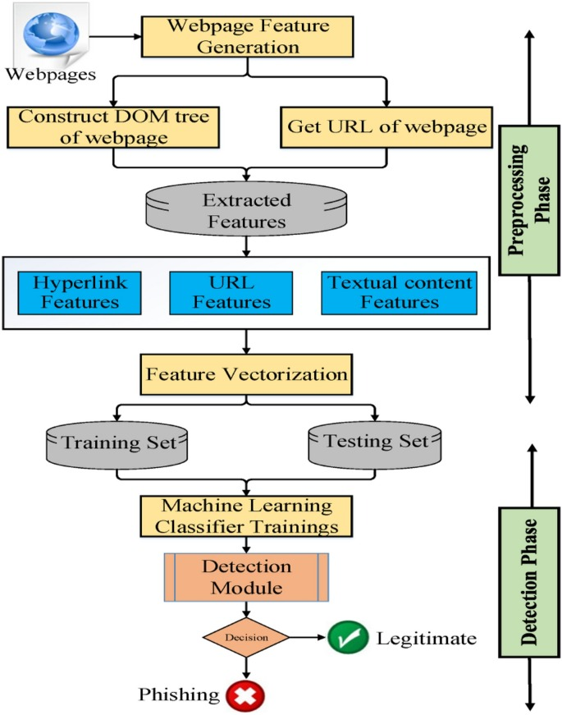
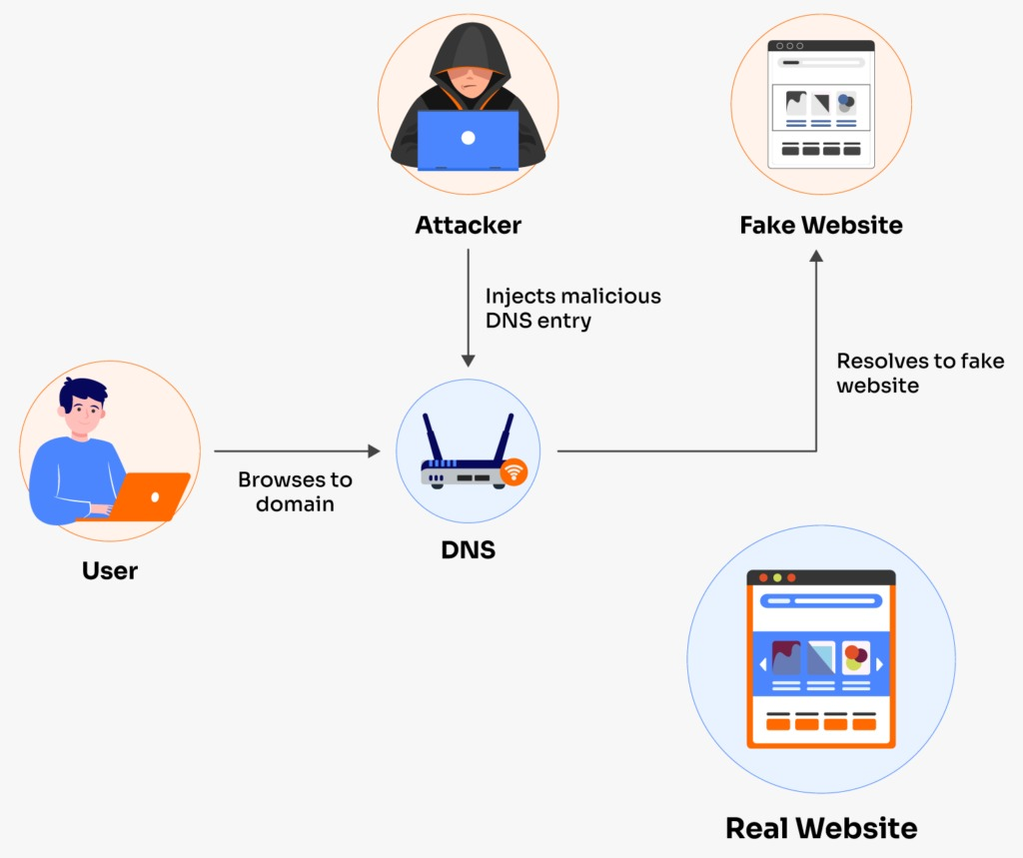
Systematic Diagrams

Slide 16
ARCHITECTURE FLOW
It’s a smart computer system that uses Artificial Intelligence (AI) and Machine Learning (ML) to find out whether a website (or domain name) is safe or a scam (phishing).
Phishing websites pretend to be real ones (like fake PayPal or bank sites) to steal your passwords, credit card info, or personal data. This tool helps people avoid getting tricked by these fake website.
How Does It Work?
Think of it like a security guard that checks every visitor (website) and decides if they’re trustworthy. It does this in steps:
1. Collects Clues About the Website
It looks at things like:
How long the website address is
Whether it uses strange characters (like "paypa1" instead of "paypal")
Whether it has a valid SSL certificate (the "lock" icon in browsers)
When the domain was created (scammers often use new domains)
Is it on known scam lists (like PhishTank or Google Safe Browsing)?
This part is called Feature Extraction.
2. Uses AI Models to Make a Decision
All the clues are given to a smart system (trained with lots of past examples). This is the Machine Learning part.
The system uses models like:
Random Forest
Support Vector Machine (SVM)
Deep Learning (like CNNs)
These models have learned the patterns of phishing sites vs. safe sites.
School or office networks

Slide 17
3. Real-Time Checking with External Help
It checks with real-time sources (via APIs) like:
Google Safe Browsing
PhishTank
VirusTotal
These services have lists of bad websites that are constantly updated.
4. Makes a Final Call
Based on all the clues and smart analysis, the system tells you:
✅ “Legitimate” (safe)
❌ “Phishing” (unsafe) It also shows a confidence score (how sure it is) and explains why it made that decision.
5. Optional Extras
It can alert users in real-time.
It can be turned into a browser plugin or email scanner.
It has a user-friendly dashboard.
📊 How Good Is It?
Accuracy: 97%
Detection Time: Less than 2 seconds
It works even if the phishing website is brand new (not yet in blacklists)
🛡️ Why Is It Better Than Old Methods?
Blacklists only catch known scams.
Heuristics use fixed rules that can be tricked.
This tool learns and adapts to new phishing tricks.
It catches zero-day phishing attacks (new ones not seen before).
🚀 Real-World Use
Safe browsing alerts
Email link scanning
Banking and financial apps
School or office networks

Slide 18
FLOW OF TOOL PROCEDURE
User Input (URL)
↓
Feature Extraction
↓
Threat Intelligence API Checks
↓
ML Model Prediction
↓
Phishing or Legitimate? → Show Result + Explanation
↓
Logging, Reporting, Learning
Take the URL
2. Extract features (e.g., URL length, domain age)
3. Query threat databases (e.g., PhishTank, VirusTotal)
4. Feed features to the 5. ML model
Get prediction (phishing or legitimate)
6. Display result with explanation

Slide 19
Conclusion
Phishing remains a significant threat in the digital world. Traditional methods fail to detect advanced phishing attacks effectively. By leveraging AI and ML techniques, our proposed system offers a comprehensive approach to phishing domain detection.
The integration of lexical analysis, visual similarity, and SSL certificate validation enhances detection accuracy and ensures better cybersecurity measures.

Slide 20
References
Abu-Nimeh, S., Nappa, D., Wang, X., & Nair, S. (2007). A comparison of machine learning techniques for phishing detection. Proceedings of the Anti-Phishing Working Group eCrime Researchers Summit.
Ma, J., Saul, L. K., Savage, S., & Voelker, G. M. (2009). Beyond blacklists: Learning to detect malicious web sites from suspicious URLs. Proceedings of the ACM SIGKDD International Conference on Knowledge Discovery and Data Mining.
Le, T., Islam, R., & Narasimhan, V. (2018). Phishers’ favorite sport: Feature selection for phishing detection. Computers & Security.
Zhang, Y., Hong, J., & Cranor, L. (2017). Cantina: A content-based approach to detecting phishing web sites. Proceedings of the ACM International Conference on World Wide Web (WWW).
Marchal, S., Saari, K., Singh, N., & Asokan, N. (2016). Know Your Phish: Novel Techniques for Detecting Phishing Sites and their Targets. IEEE Transactions on Dependable and Secure Computing.
Verma, R., & Das, A. (2017). What's in a URL? Analyzing Features for Phishing Detection. Proceedings of the 2017 IEEE International Conference on Data Mining Workshops.
Fette, I., Sadeh, N., & Tomasic, A. (2007). Learning to detect phishing emails. Proceedings of the 16th International Conference on World Wide Web.
Basit, A., Zafar, M., Liu, X., Javed, A. R., & Jalil, Z. (2021). A Comprehensive Survey of AI-enabled Phishing Attacks Detection Techniques. Telematics and Informatics.
Bahnsen, A. C., Torroledo, M., Camacho, T., & Villegas, S. (2017). DeepPhish: Simulating Malicious AI. International Workshop on Cyber Crime Investigation and Digital Forensics.
Mohamed, E., Belguith, S., & Boudriga, N. (2020). Anti-Phishing Model Using CNN for URL Classification. Future Internet.

Slide 21
Thank You

